Slide 1
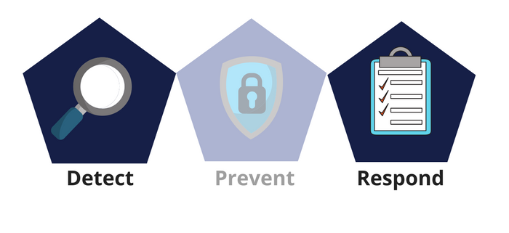



Network Security
Class IX
lab 28

Slide 2
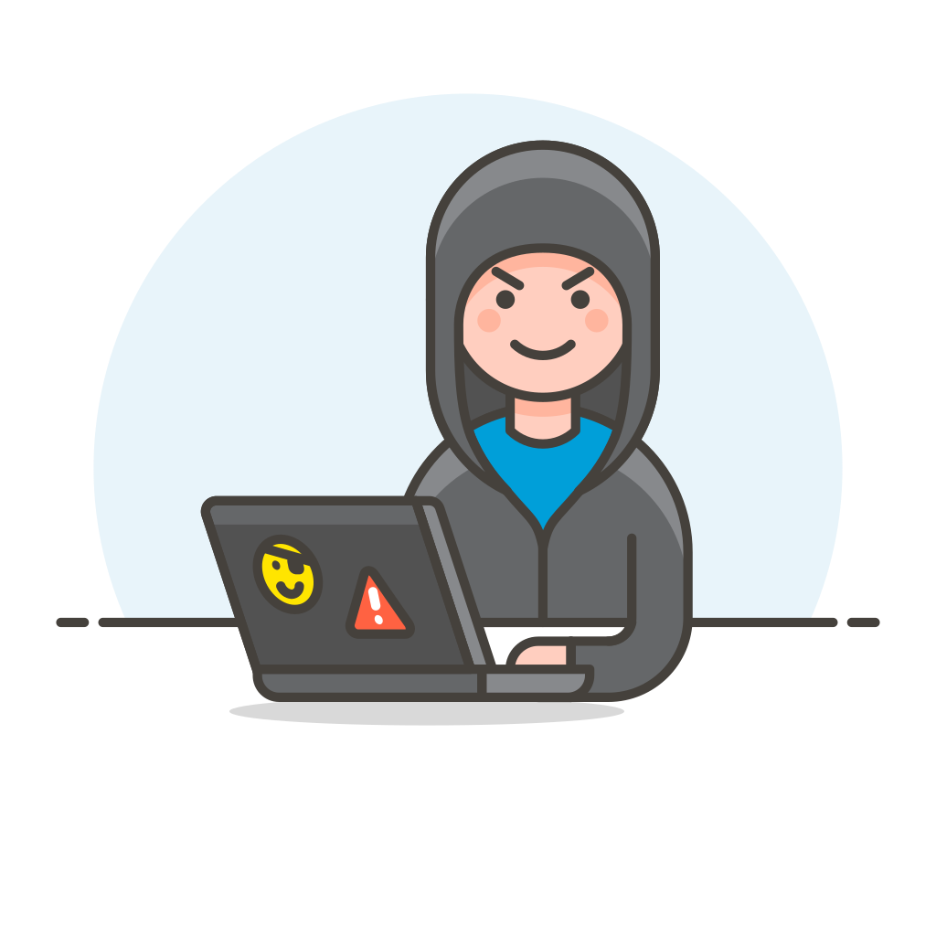

NMAP
used widely for network discovery and security auditing

Slide 3

Metasploit
Conduct basic penetration tests on small networks

Slide 4

Burp Suit
performs security testing of web applications

Slide 5
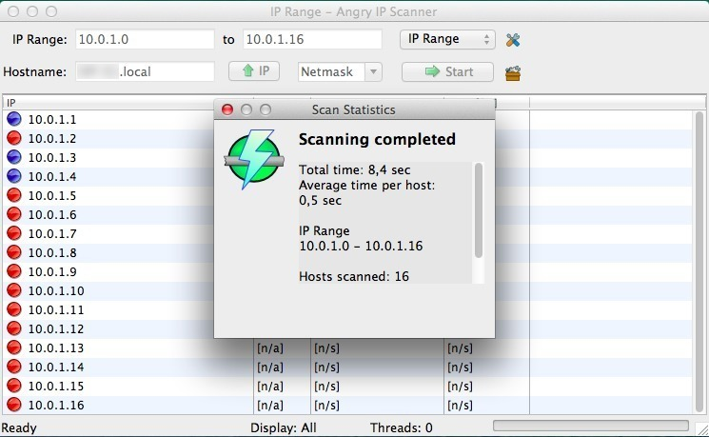
Angry IP Scanner
cross-platform IP address and port scanner

Slide 6

Cain & Abel
a password recovery tool for Microsoft Operating Systems

Slide 7

Ettercap
network security tool for Man-in-the-Middle attacks

Slide 8

QualysGuard
It delivers critical security intelligence on demand and used for network security auditing

Slide 9
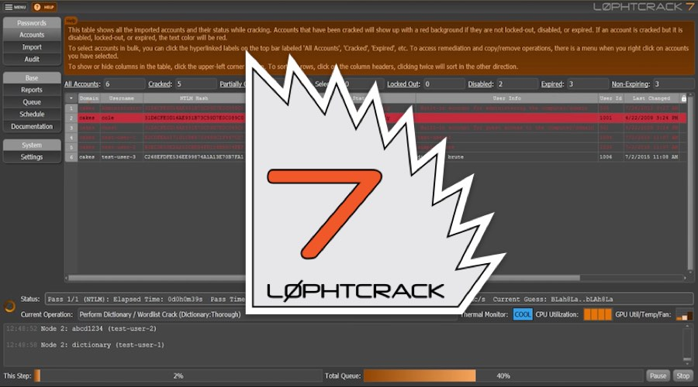
LC4
password auditing
and recovery application

Slide 10

Network Stumbler
WiFi scanner and monitoring tool for Windows

Slide 11
Thank You

